Slide 1
Test Suites and Cases

Slide 2
Test Suite
Not in the IEEE 829 list of definitions
Generally defined as a collection of test cases
Based on a feature or function
Based on a particular configuration
Based on a testing goal

Slide 3
IEEE 829 – Test Case
3.1.41 test case: (A) A set of test inputs, execution conditions, and expected results developed for a particular objective, such as to exercise a particular program path or to verify compliance with a specific requirement. (B) Documentation specifying inputs, predicted results, and a set of execution conditions for a test item.

Slide 4
Test Script
Generally synonymous with Test Case
Sometimes intended to differentiate an automated (script) from a manual (case) test

Slide 5
All Types of Testing
Test cases can be defined for each kind of testing
Unit Testing (not very common)
Integration Testing
System Testing (and all the sub-types)
Acceptance Testing
Smoke Testing

Slide 6
Key Components for a Test Case
Attribute | Description
Unique Id | Used as a reference for all kinds of things like defining a defect, reporting results, cross reference, etc.
Title | Descriptive phrase indicating the purpose of the test
Preconditions | All constraints that must be satisfied to successfully execute the test and generate the expected behavior
Execution Steps | The sequence of actions to execute the test along with specific data
Expected Result | The desired outcomes from executing the steps with the preconditions satisfied
Test Case Status (Disposition) | Not Executed, Failed, Passed, Blocked

Slide 7
Writing Test Cases
Manual Approach
Use Spreadsheets to record each test case
Easy to get started
Adequate for small efforts
Difficult to manage for large testing efforts
Automated Approach
Efficient to manage
Better reporting
Relatively inexpensive options available
The preferred approach by far

Slide 8
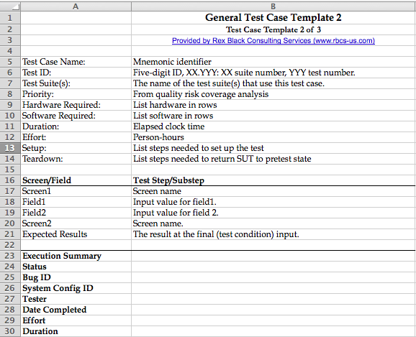
Excel Based Template 1

Slide 9
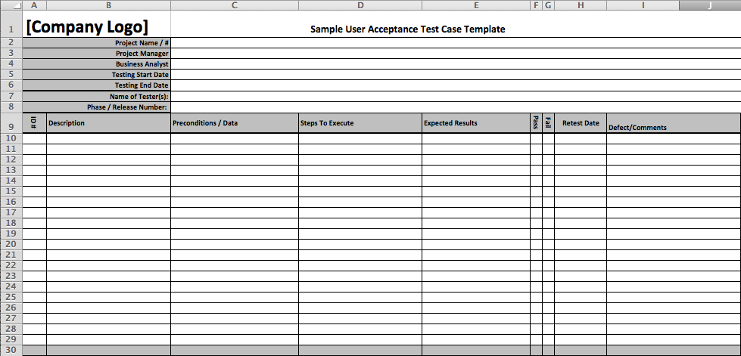
Excel Based Template 2

